Slide 1
Integration
Briane Paul Samson
@brianehenyo

Slide 2

“Model” and “Controller” classes from DEV
“View” classes from ANA
How do we fit your pieces of code together?

Slide 3
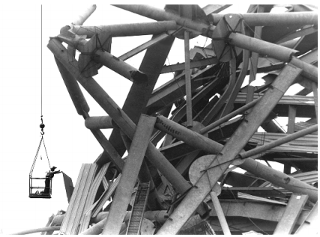
This football stadium add-on would have been strong enough when completed, but it was constructed in the wrong order
– an integration error.

Slide 4
In today’s discussion
Importance of an Integration Approach
Frequency
Incremental Integration Strategies
Daily Build and Smoke Test

Slide 5
Is Integration a Construction or a Testing activity?

Slide 6
Benefits of a careful integration
Easier defect diagnosis
Fewer defects
Less scaffolding (temporary structure)
Shorter overall development schedule
More reliable schedule estimates
What else can you think of?

Slide 7
Integration Frequency

Slide 8
Integration cannot begin until late in the project development schedule.
Do you agree or disagree?

Slide 9
Phased Integration
Unit development
Design, code, test, and debug each class/module
System integration
Combine all the classes
System dis-integration
Test and debug the whole system
What problems could occur in this kind of approach?

Slide 10
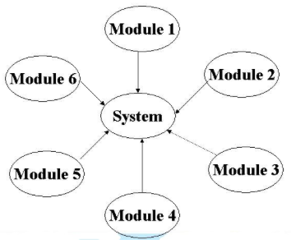
Problems
Since everything is put together the first time, new problems inevitably surface
Causes of errors could be anywhere
Uncertainty of location of problems + all show up at once = CHAOS!
aka “Big Bang integration”

Slide 11
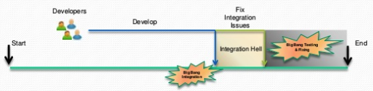
Big Bang Integration Hell
Late check-in of code ➔ All features get tested at once

Slide 12
Incremental Integration
Write and test a program in small pieces,
then combine one at a time.
Develop a small, functional part of the system - skeleton
Design, code, test, and debug a class
Integrate the new class with the skeleton
What are the benefits of this kind of approach?

Slide 13
Benefits
Errors are easy to locate
The system succeeds early in the project
Improved progress monitoring
The units of the system are tested more fully
You can build the system with a shorter development schedule

Slide 14
Incremental Integration Strategies
Top-Down
Bottom-Up
Sandwich
Risk-oriented
Feature-oriented

Slide 15
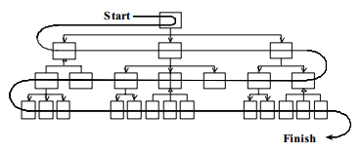
Top-Down
Follows the control flow or architectural structure (e.g., from main menu)
Missing components are temporarily substituted by stubs

Slide 16
Disadvantages
A lot of stubs to integrate from top-down
Almost impossible to implement fully
Cannot be used if the collection of classes does not have a “top“

Slide 17
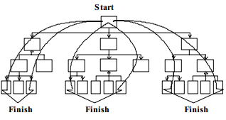
Top-Down Alternative

Slide 18
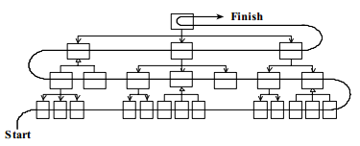
Bottom-Up

Slide 19
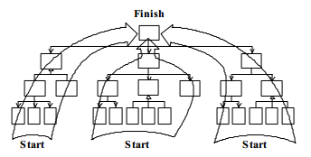
Bottom-Up Alternative

Slide 20
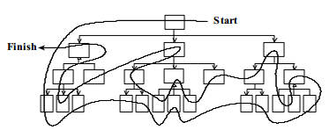
Sandwich
Notes:
In sandwich integration, you integrate top-level and widely used bottom-level classes first, and save middle-level classes for last.

Slide 21
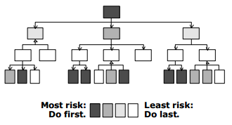
Risk-Oriented
Notes:
In risk-oriented integration, you integrate classes that you expect to be most troublesome first; you implement easier classes later.

Slide 22
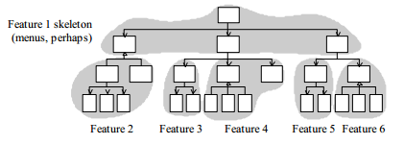
Feature-Oriented
Notes:
In feature-oriented integration, you integrate classes in groups that make up identifiable features—usually, but not always, multiple classes at a time.

Slide 23
Now, what will you use for your projects?

Slide 24
Daily Build & Smoke Test

Slide 25
Daily Build & Smoke Test
Where every class is compiled, linked, and combined into an executable program every day
The program is then put through a “smoke test”
Will the software “smoke”
when it is executed?

Slide 26
Benefits
Reduced risk of low quality
Easier defect diagnosis
Improves team morale
It surfaces work that can otherwise accumulate unseen

Slide 27


Slide 28
Build Daily
Heartbeat or sync pulse of a project
It allows developers’ code to come back into alignment

Slide 29
Check for broken builds
At a minimum, a “good” build should:
Compile all classes and other components successfully
Link all classes and other components successfully
Not contain any showstopper bugs
Pass the smoke test

Slide 30
Smoke Test
Should exercise the entire system from end to end
Not necessarily exhaustive, but it should be capable of exposing major problems
If the build passes, you can assume that it is stable enough to be tested more thoroughly

Slide 31
A daily build without smoke test is a time-wasting exercise.

Slide 32
The smoke test must evolve as the system evolves.

Slide 33
Automate the daily build and smoke test.

Slide 34
Establish a build group* *for big projects

Slide 35
Add revisions to the build only when it makes sense to do so.

Slide 36
…but don’t wait too long to add a set of revisions. Divide the construction of a single feature into multiple episodes.
Notes:
Beware of checking in code infrequently. It’s possible for a developer to become so embroiled in a set of revisions that every file in the system seems to be involved. That undermines the value of the daily build. The rest of the team will continue to realize the benefit of incremental integration, but that particular developer will not. If a developer goes more than a couple of days without checking in a set of changes, consider that developer’s work to be at risk. As Kent Beck points out, frequent integration sometimes forces you to break the construction of a single feature into multiple episodes. That overhead is an acceptable price to pay for the reducedintegration risk, improved status visibility, improved testability, and other benefits of frequent integration (Beck 2000).

Slide 37
Smoke test your own code before adding to the build. Create a Staging environment with the latest build.

Slide 38
Create a penalty for breaking the build. Keeping the build healthy is the project’s top priority.

Slide 39
Release builds in the morning.

Slide 40
Build and smoke test even under pressure. Under stress, developers lose some of their discipline.

Slide 41
What kinds of projects can use the Daily Build approach?

